Slide 1
Session Outline
Overview of Unsupervised learning & Clustering
Kmeans
Kmeans ++
Kprototype
Hierarchical Clustering
DBSCAN
Comparison & Industry Applications
Code walkthrough

Slide 2
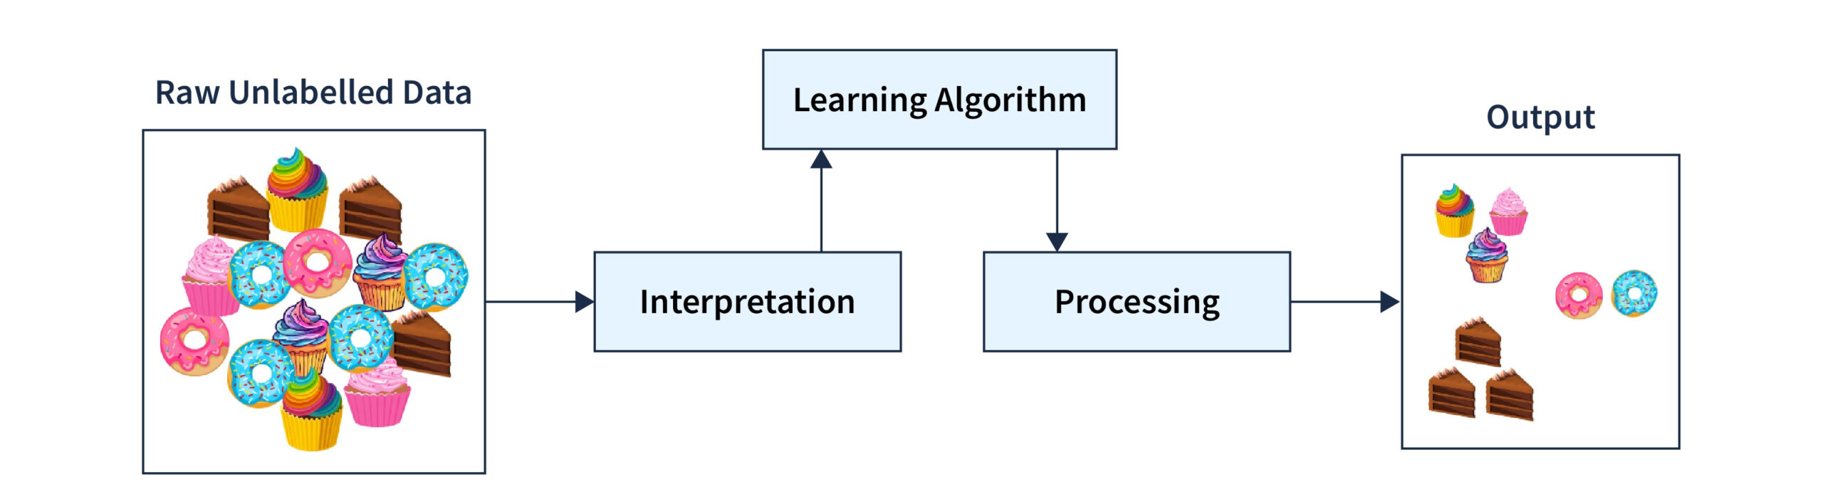
Unsupervised Learning
Clustering
Dimensionality Reduction

Slide 3
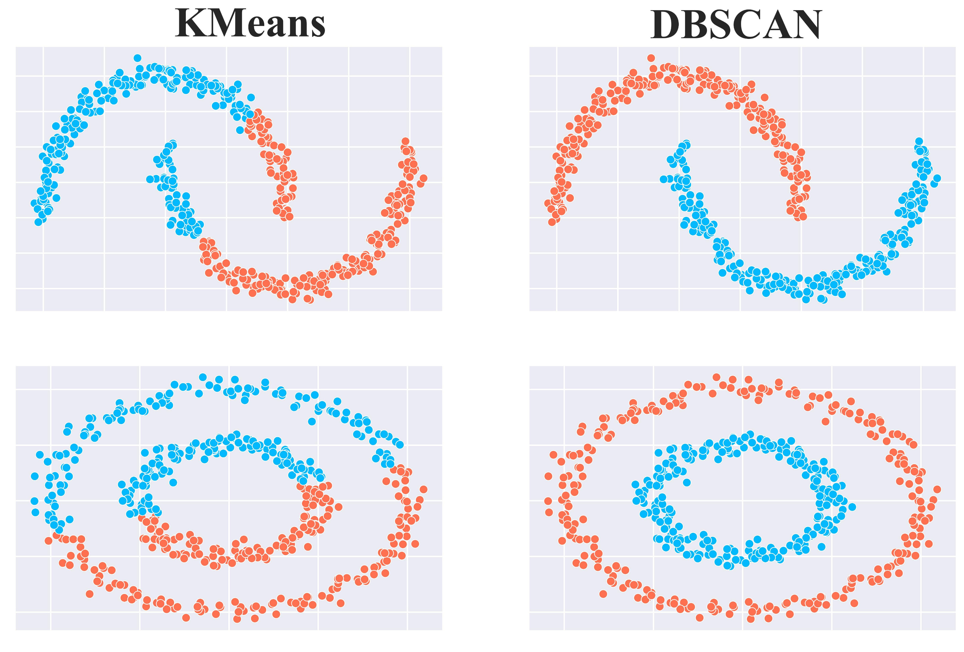
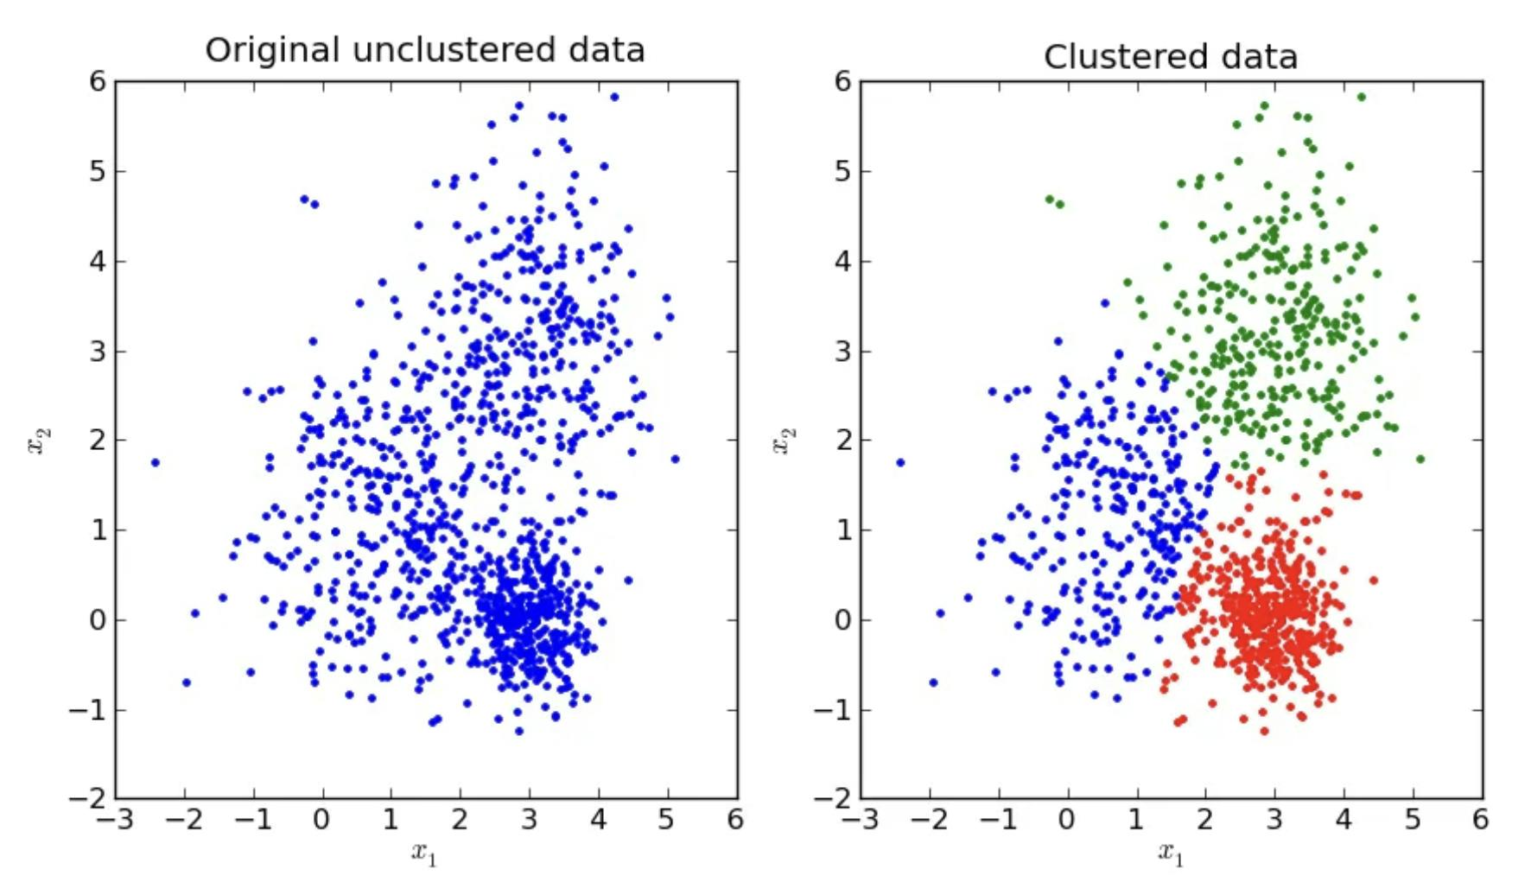
Clustering

Slide 4


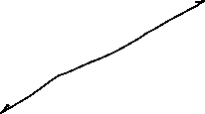


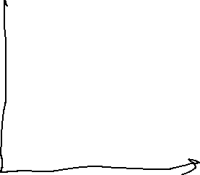

Terminology

Slide 5


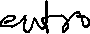
Terminology

Slide 6
KMeans Clustering
Select the number of clusters: Choose the value of 𝑘, which is the number of clusters you want to identify in your data.
Randomly assign centroids: Select 𝑘 distinct data points at random to serve as the initial centroids for each cluster.
Calculate distances: Measure the distance between each data point and each centroid.
Assign points to clusters: Assign each data point to the centroid that is closest to it.
Update centroids: Find the new location of each centroid by calculating the mean of all the data points in its cluster.
Repeat: Repeat steps 3–5 until the centroids no longer change position

Slide 7
KMeans Clustering

Slide 8
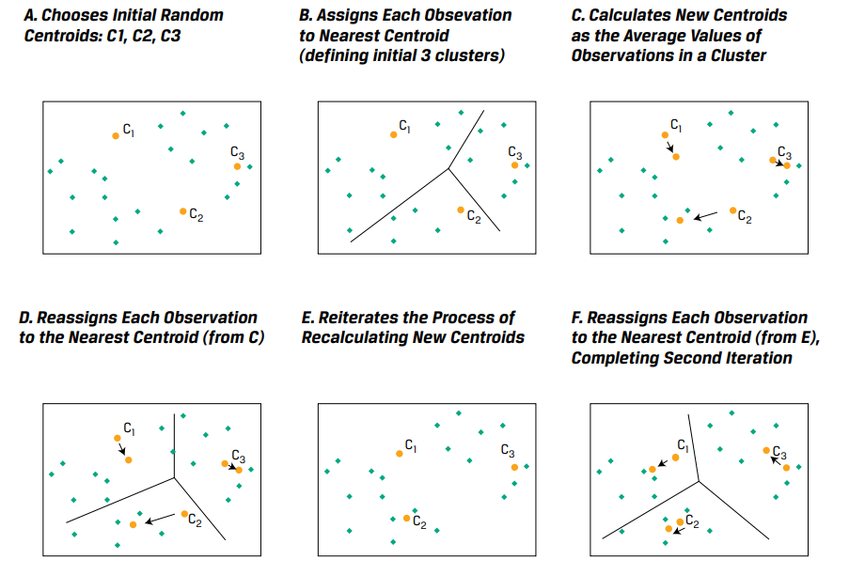
KMeans Clustering

Slide 9

KMeans Clustering

Slide 10
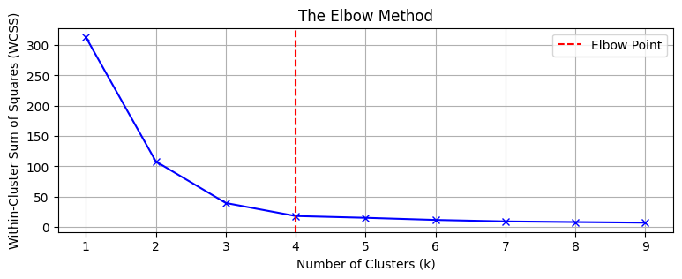
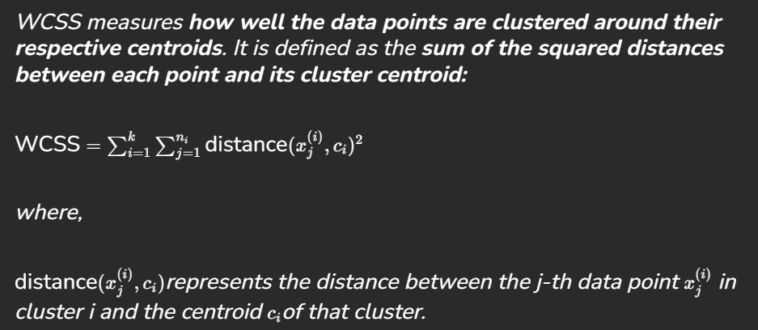
KMeans Clustering

Slide 11
KMeans Clustering
Advantages:
Ease of implementation
Scalable
Easy to understand
Disadvantages:
Number of clusters not determined by algorithm
Prone to outliers
Initial cluster centroids is random

Slide 12
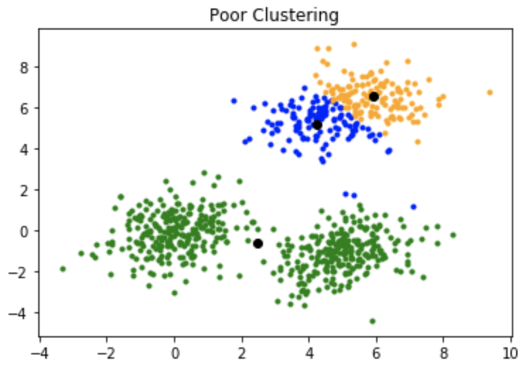
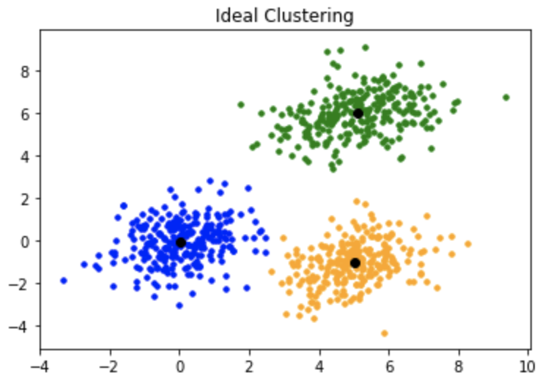
Kmeans++ Clustering

Slide 13
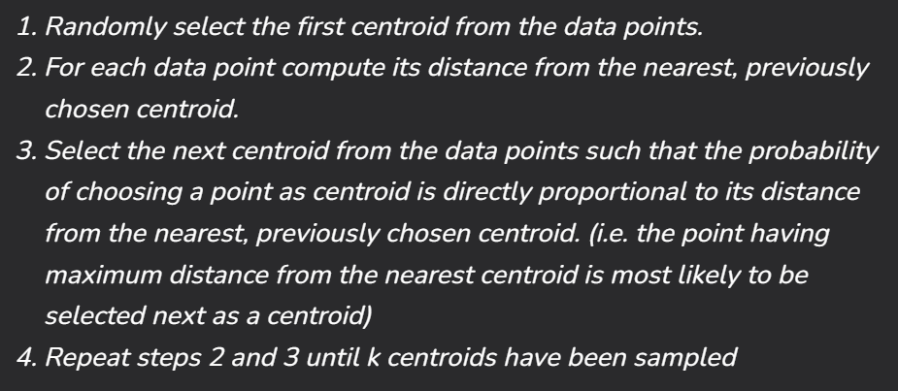
Kmeans++ Clustering

Slide 14
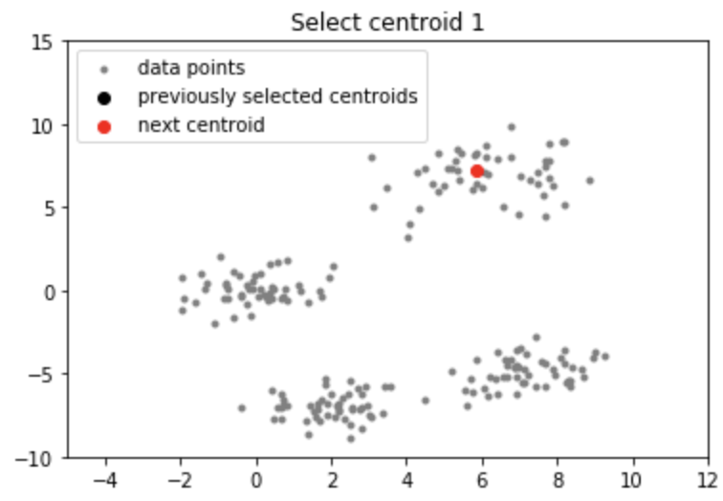
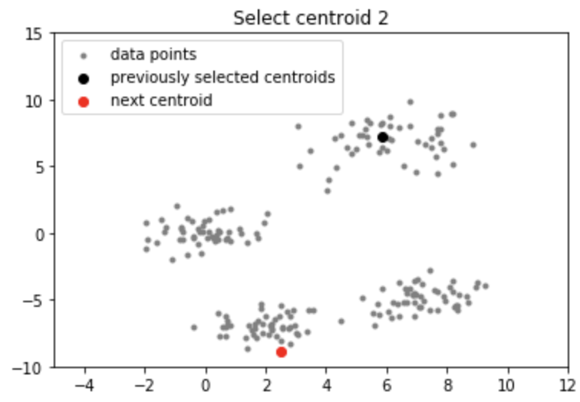
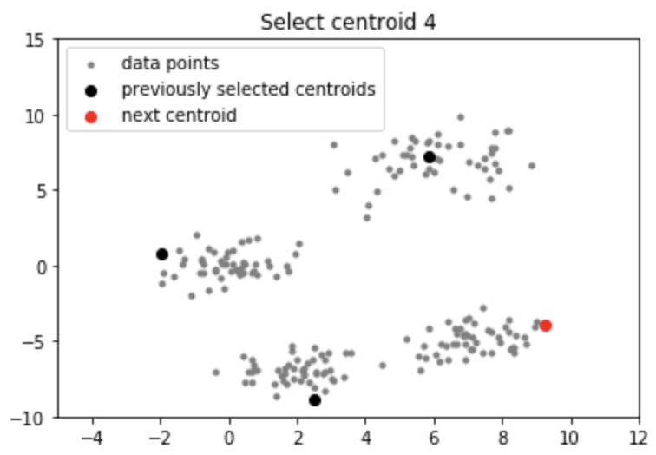
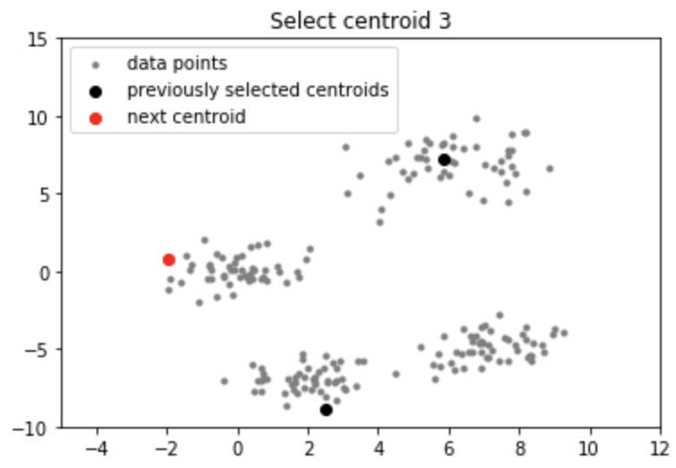
Kmeans++ Clustering

Slide 15
Kmeans++ Clustering
Centroids far from each other
Increases the chances of initially picking up centroids that lie in different clusters
Since centroids are picked up from the data points, each centroid has some data points associated with it at the end.

Slide 16
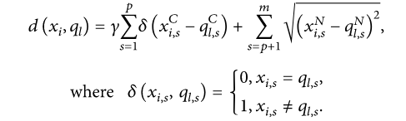
K Prototype
K-means is not designed to handle categorical data
Euclidian distance as a measure of distance between categorical data points is not very meaningful. For instance, how would you calculate the distance between ‘blue’ and ‘green’, or ‘apple’ and ‘banana’?
The K-Prototypes algorithm does this by introducing a combined dissimilarity measure. For numerical attributes, the dissimilarity measure is the same as in K-means — the squared Euclidean distance. For categorical attributes, the measure is a simple matching dissimilarity measure, as in the K-modes algorithm.

Slide 17

K Prototype

Slide 18





K Prototype

Slide 19
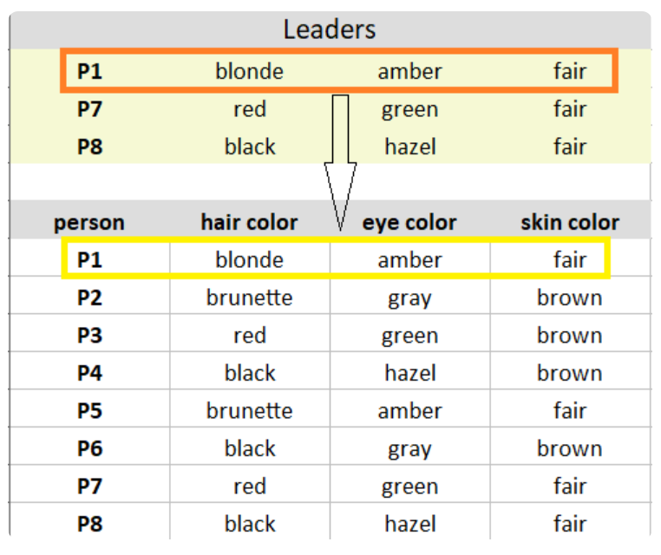
K Prototype
https://www.analyticsvidhya.com/blog/2021/06/kmodes-clustering-algorithm-for-categorical-data/#:~:text=Step%201:%20Pick%20K%20observations,End%20Note
https://medium.com/analytics-vidhya/customer-segmentation-using-k-prototypes-algorithm-in-python-aad4acbaaede

Slide 20
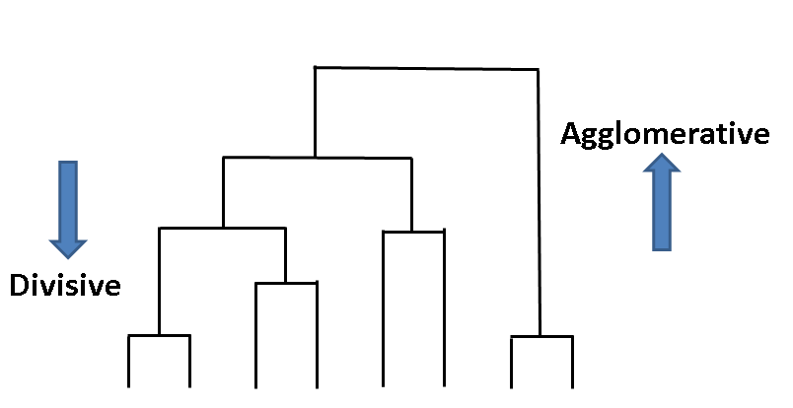
Hierarchical Clustering
Agglomerative
Divisive
Start with the points as individual clusters
At each step, merge the closet pairs of clusters until only 1 is left
Start with one, all inclusive cluster
At each step, split the cluster until each cluster contains a point

Slide 21
Agglomerative Clustering

Slide 22
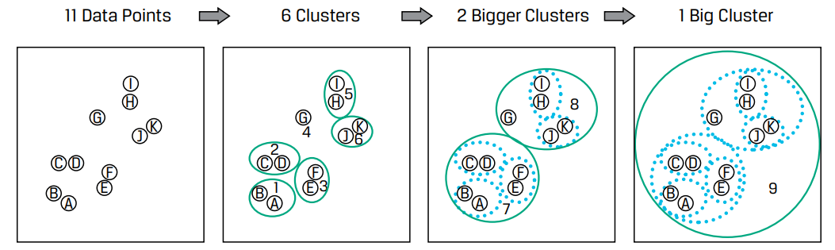
Agglomerative Clustering
Compute the distance matrix: Calculate the distance between each pair of data points.
Assign data points to clusters: Treat each data point as a separate cluster.
Merge the closest clusters: Find the two clusters that are closest together and merge them.
Update the distance matrix: Update the distance matrix to reflect the new clusters.
Repeat: Repeat steps 1–4 until all clusters are merged into one.
Create a dendrogram: Visualize the clusters using a dendrogram.

Slide 23

Agglomerative Clustering

Slide 24
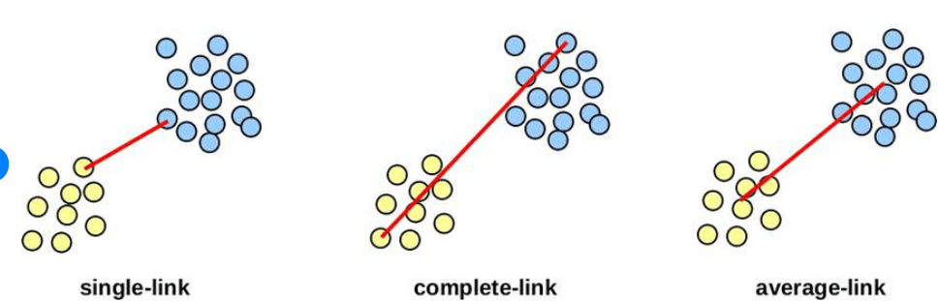
Agglomerative Clustering - Linkages

Slide 25


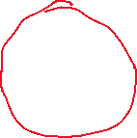
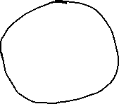


Slide 26
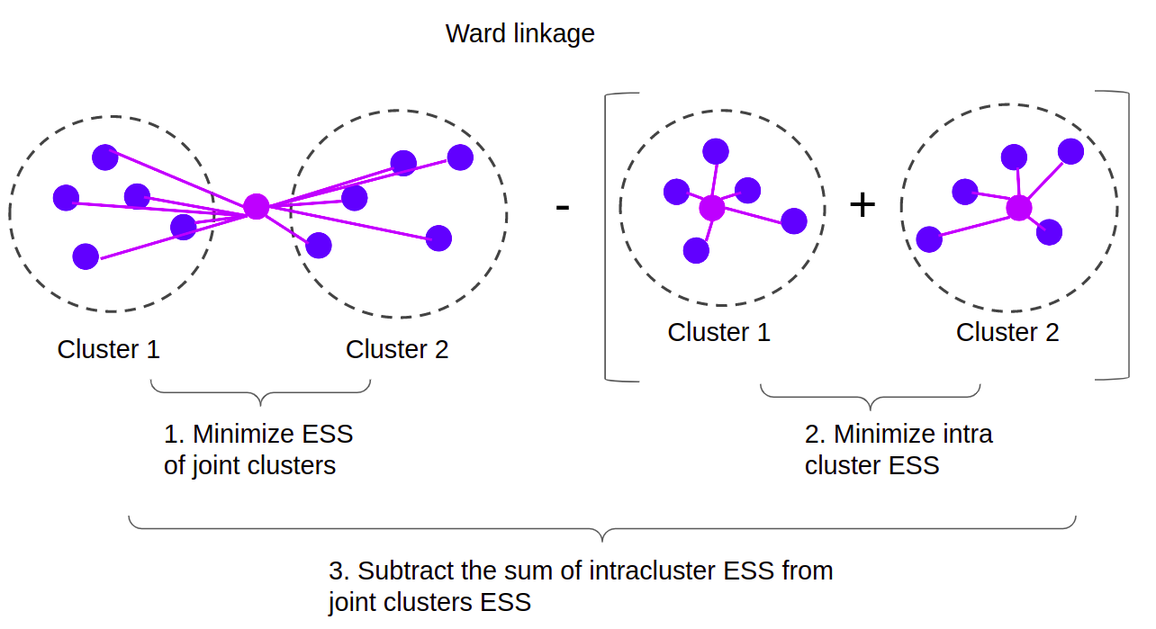
Agglomerative Clustering - Linkages

Slide 27
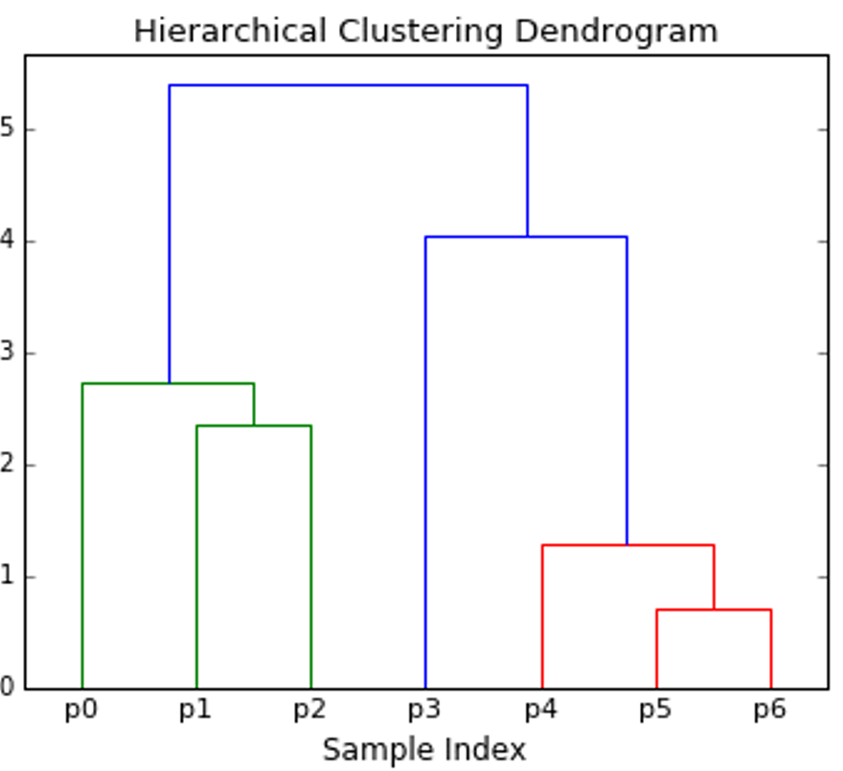
Agglomerative Clustering – Number of clusters

Slide 28
DBSCAN
DBSCAN is a density-based clustering algorithm that groups together data points that are closely packed while marking points in low-density areas as noise. It does not require specifying the number of clusters beforehand and can discover clusters of arbitrary shape.
Key Concepts:
Density-Based Clustering:
Clusters are defined by dense regions of data points separated by sparse regions.
Two Key Parameters:
ε (epsilon): The radius to search for neighboring points.
minPts: Minimum number of points required to form a dense region.

Slide 29
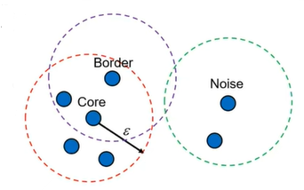
DBSCAN
Core Points:
Have at least minPts within distance ε (including itself).
These points form the backbone of the cluster.
Border Points:
Have fewer than minPts in their ε-neighborhood but are reachable from a core point.
They belong to a cluster but do not initiate new
clusters.
Noise (Outliers):
Points that do not belong to any cluster and are not reachable from any core point.

Slide 30


DBSCAN

Slide 31
DBSCAN - Steps
Select values of Min points and epsilon, and a point randomly
Check for neighbors within distance ε:
If the number of neighboring points is less than MinPts, the point is labeled as noise (for now).
If there are at least MinPts points within ε distance, the point is marked as a core point, and a new cluster is formed
Expand the cluster:
All the neighbors of the core point are added to the cluster.
For each of these neighbors:
If it's a core point, its neighbors are added to the cluster recursively.
If it's not a core point, it's marked as a border point, and the expansion stops
Repeat until no more density-reachable points are left.
Move to the next unvisited point and repeat the process.

Slide 32
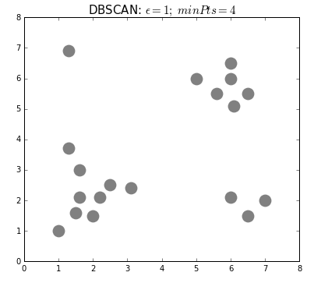
DBSCAN

Slide 33
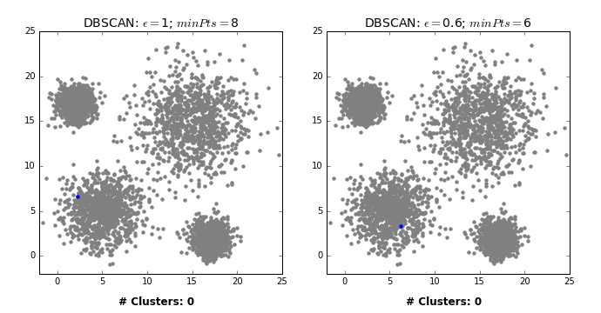
DBSCAN

Slide 34
DBSCAN
Advantages of DBSCAN:
Can find clusters of arbitrary shape and size.
No need to specify the number of clusters.
Handles noise well.
Disadvantages of DBSCAN:
Struggles with clusters of varying densities.
Sensitive to parameter choice (ε and minPts).

Slide 35
KMeans vs DBSCAN

Slide 36
Clustering Algorithm - Comparison
Feature | K-Means | Agglomerative Clustering | DBSCAN
Cluster Shape | Spherical | Arbitrary | Arbitrary (density-based)
Initialization | Random | No random initialization needed | No random initialization needed
Number of Clusters | Pre-specified | Determined via dendrogram | Determined automatically
Handling Outliers | Poor | Better | Excellent
Performance on Large Datasets | Good | Slow (due to pairwise distance) | Good
Interpretability | Easy (centroids) | Moderate (dendrogram) | Moderate (density clusters)
Type of Clustering | Partition-based | Hierarchical | Density-based

Slide 37
Clustering Algorithm - Choice
Use K-Means if:
Data is well-separated and compact (e.g., spherical clusters).
You need a fast and scalable solution.
The number of clusters is known beforehand.
Use Agglomerative Clustering if:
You want a hierarchy of clusters (e.g., for exploratory analysis).
You have small to medium-sized datasets.
Cluster shapes may not be spherical.
Use DBSCAN if:
You have clusters of arbitrary shape and varying density.
You want to detect outliers efficiently.
The number of clusters is unknown.

Slide 38
Clustering Applications
Application | Preferred Clustering Algorithm | Reason
Customer Segmentation (Retail, Banking, etc.) | K-Means | Handles large datasets efficiently, assumes well-separated clusters, and provides clear segment centroids.
Geographic Clustering (Crime Hotspots, Epidemic Spread) | DBSCAN | Handles spatial data well, detects clusters of arbitrary shape, and ignores noise (outliers).
Customer Churn Prediction (Telecom, SaaS) | K-Means | Provides well-defined, compact customer groups, enabling actionable insights.
Traffic Pattern Analysis (Transportation Planning) | DBSCAN | Works well with spatial-temporal data, handles noise and complex traffic clusters effectively.
Hierarchy of Product Categories (E-commerce, Store layout) | Hierarchical Clustering | Builds a natural tree-like structure for product classifications.
Climate Zone Classification (Meteorology) | DBSCAN | Identifies irregular climate regions with different density distributions.

Slide 39
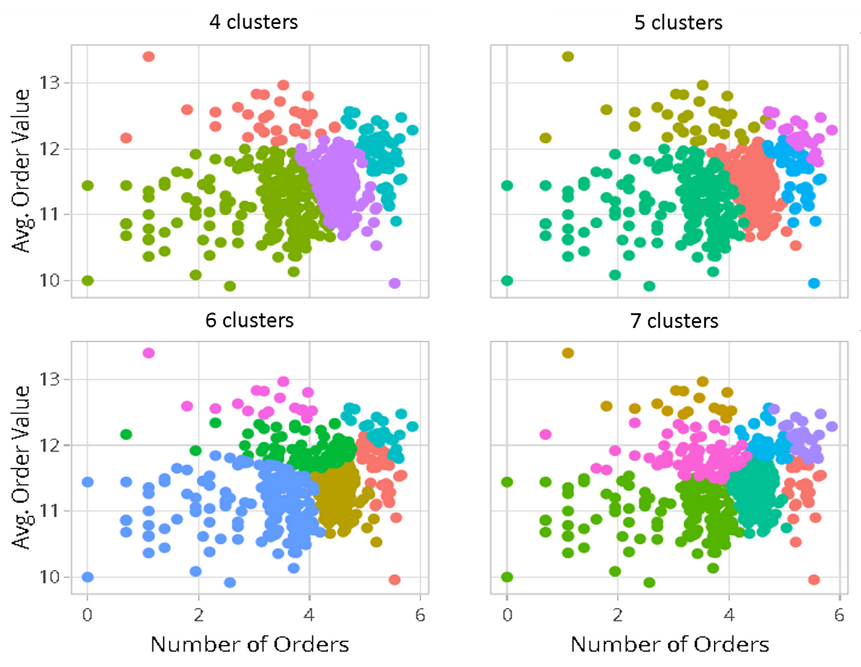
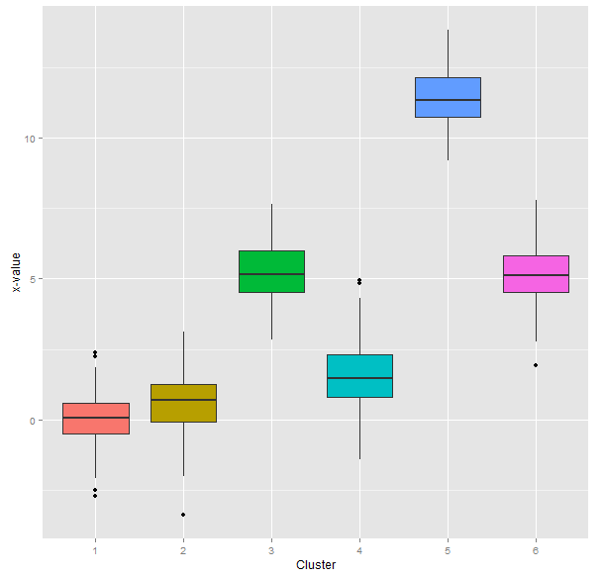
Cluster Profiling
Cluster profiling is a tool that helps validate if groups formed by clustering techniques are relevant to a business. It can also help understand how customers are grouped

Slide 40
What does K-Means++ improve over the original K-Means algorithm?
a) It uses a density-based approach to select centroids b) It selects centroids more carefully to improve convergence speed and quality c) It performs hierarchical clustering for better accuracy d) It automatically determines the number of clusters

Slide 41
In K-Means++, the probability of selecting a data point as a centroid is proportional to:
a) The Euclidean distance from the other points b) The distance from the cluster's centroid c) The inverse of the distance from the nearest centroid d) The distance between all the data points

Slide 42
In DBSCAN, a core point is a point that:
a) Has at least a minimum number of points within distance ε b) Is not part of any cluster c) Has no neighbors within distance ε d) Is reachable from another core point

Slide 43
Which of the following statements about DBSCAN is true?
a) It requires the number of clusters to be specified b) It works only with numerical data c) It can identify noise and outliers d) It does not require the definition of any parameters

Slide 44
The silhouette coefficient is used to evaluate the quality of clustering based on:
a) Cluster separation and cohesion b) The number of clusters c) The number of iterations d) The distance between centroids

Slide 45
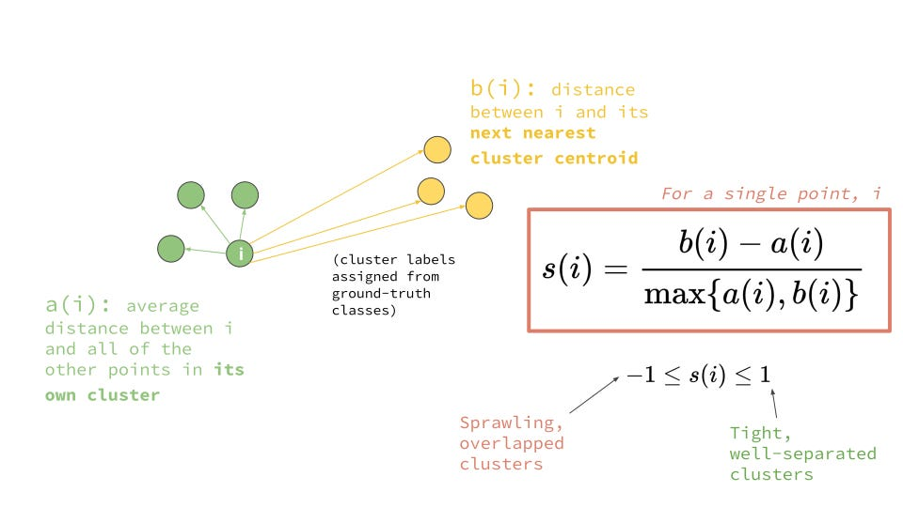

Slide 46
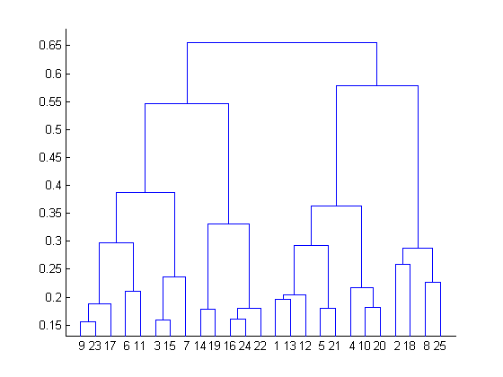
What is the most appropriate no. of clusters for the data points represented by the following dendrogram?
a) 2
b) 4
c) 6
d) 8

